Slide 1

Title: Web Scraping and Exploratory Data Analysis Washing Machine

Slide 2
About Us:
I am S. Lakshmi MCA graduate passionate about Data Analytics and Visualization.
Exploring data-driven insights through real-world datasets.
Interested in web data extraction and business trend analysis.
LINKEDIN: https://.linkedin.com/in/lakshmi-sampathi-6b10ba305
GITHUB: https://github.com/sampathilakshmi959

Slide 3
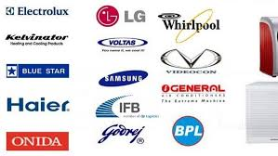
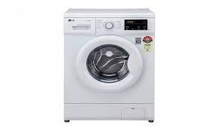
Washing Machine

Slide 4
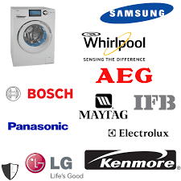
Introduction:
A washing machine is a household appliance used to wash clothes automatically.
It saves time, water, and manual effort compared to traditional hand washing.
Modern machines perform washing, rinsing, and drying in one cycle.
There are two main types: semi-automatic and fully automatic.

Slide 5
Business Problem:
Many households still depend on manual washing, which is time-consuming and labor-intensive.
ack of awareness about energy-efficient and water-saving machines leads to higher utility costs.
Consumers face difficulty in choosing the right model due to limited product understanding..
Traditional washing methods often result in poor cleaning quality and fabric damage..

Slide 6
Objectives:
To design a washing machine that reduces manual effort and saves time.
To introduce energy-efficient and water-saving technologies.
To make washing machines more affordable and user-friendly.
To promote the use of smart washing solutions in every household.

Slide 7
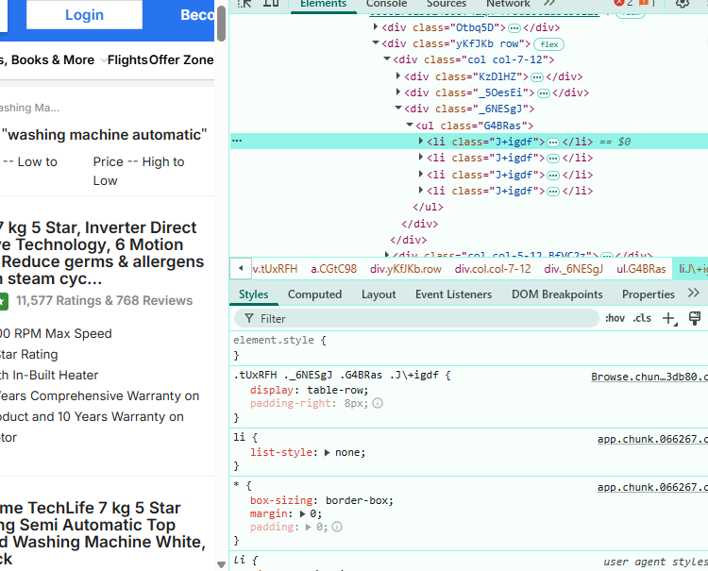
Web Scraping:
flipkart official website was selected as the main data source
Used browser developer tools (Inspect Element) to identify relevant HTML elements in match data pages
Used BeautifulSoup and Requests libraries in Python to extract structured data from the web pages
Sent HTTP requests to automate the retrieval of multiple match records across seasons
Cleaned and consolidated scraped data for further analysis and visualization.

Slide 8
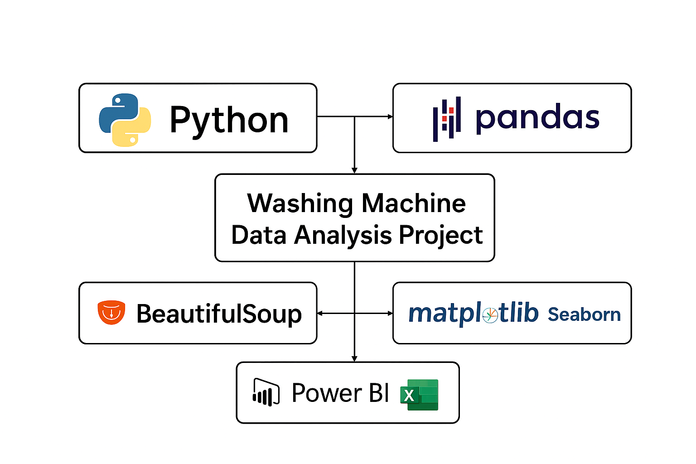
Tools Used:

Slide 9
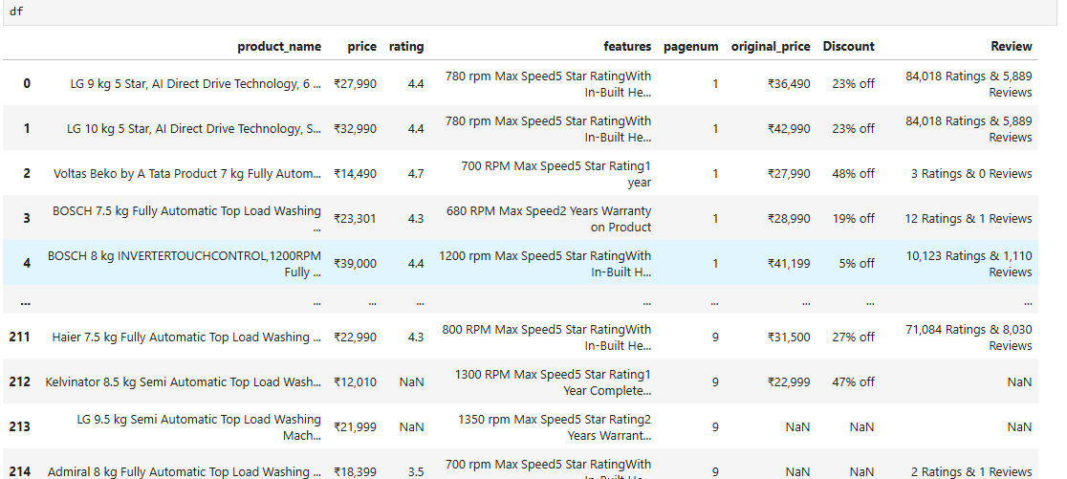
Data Cleaning Steps:
Removed duplicate or irrelevant records from sensor and usage data.
Corrected inconsistent formats in date, time, and product model fields.
Filled missing values for features like price, broed
Original_price, and cycle duration.
Standardized categorical data such as wash programs, machine types, and defect labels.
Verified data consistency to ensure accurate analysis and reporting.

Slide 10
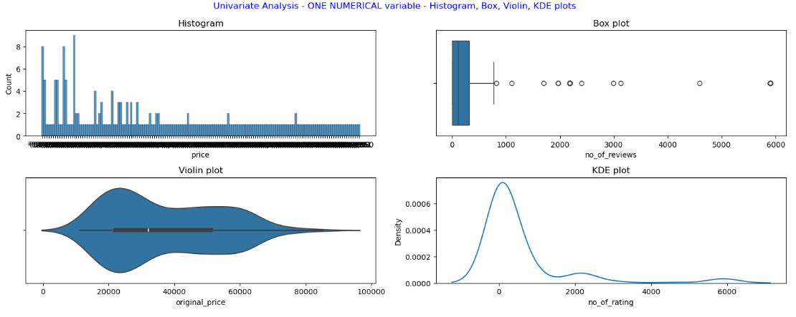
Data Visualization:
Uni-Variate Analysis
Most washing machines use 1.2–1.6 kWh power and 40–60 L water per wash.
Cycle durations mostly range from 20–30 minutes, showing efficient performance..
Correlation heatmap shows a strong link between power, water, and duration.

Slide 11
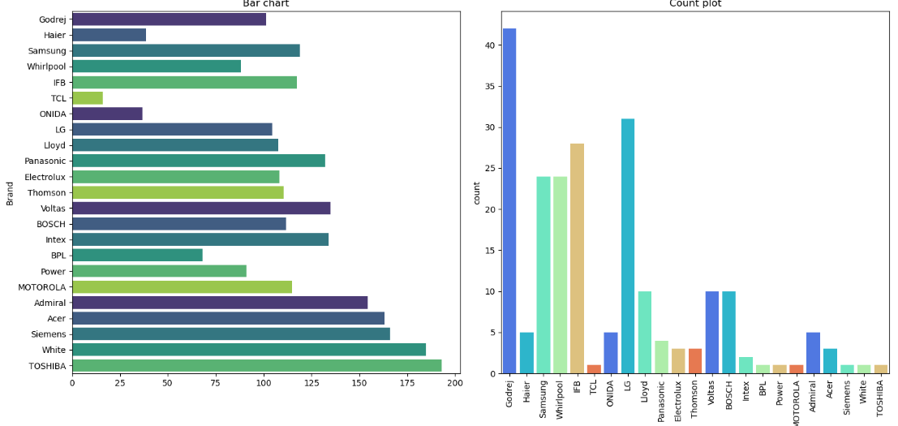
Data Visualization:
The bar chart shows that TOSHIBA has the highest count, followed closely by White and Siemens.
The count plot reveals that Godrej has the highest count among the brands listed on the x-axis.
The charts appear to be displaying different aspects of the same data, with the bar chart showing a more detailed breakdown of the counts for each brand.

Slide 12
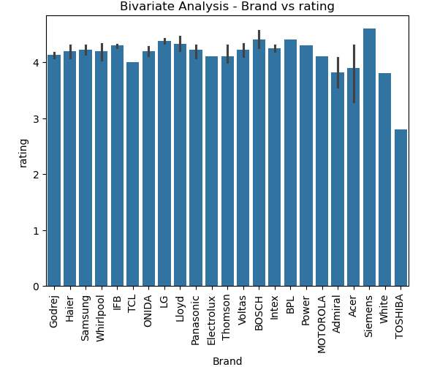
Data Visualization:
Bi-Variate Analysis
The graph shows the ratings of various brands, with some brands having higher ratings than others.
The error bars indicate the margin of error for each brand's rating.
The graph appears to be a bivariate analysis, examining the relationship between the brand and its rating.

Slide 13
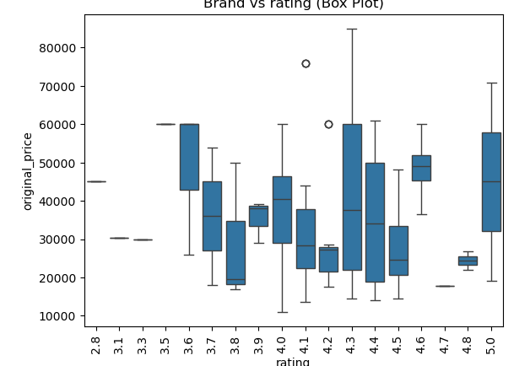
Data Visualization:
Rating Distribution: The ratings are categorized into distinct groups, with each group represented by a box plot. The ratings range from 2.8 to 5.0, indicating a diverse set of product ratings.
Original Price Range: The original prices vary significantly, with a range of 10,000 to 80,000. This suggests that the products represented in the plot have a wide range of price points.
Outliers: Two outliers are visible in the plot, one at a rating of 4.3 and another at a rating of 3.9. These outliers indicate that there are some products with significantly higher or lower prices compared to the rest of the products within their respective rating categories.

Slide 14
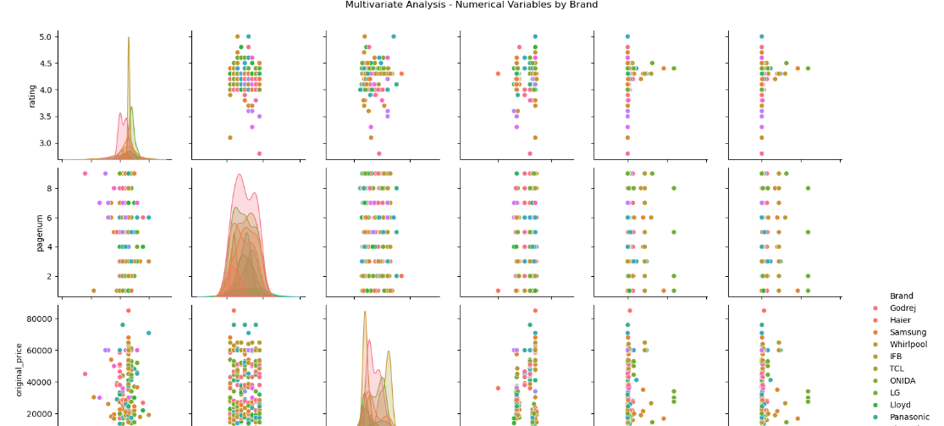
Data Visualization:
Multi-Variate Analysis
The scatter plots reveal a positive correlation between the numerical variables and the brand, indicating that certain brands tend to have higher or lower values.
The density plots show that the distribution of numerical values varies across brands, with some brands exhibiting a more skewed or bimodal distribution.
The use of different colors for each brand allows for easy comparison and identification of patterns across the different brands.
.

Slide 15
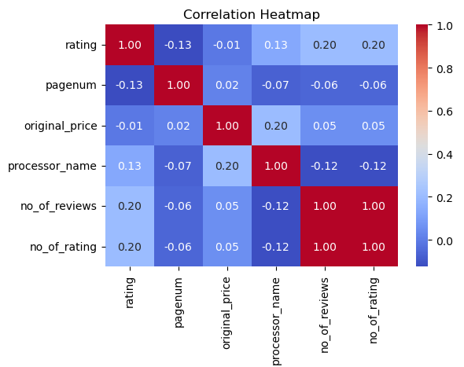
Data Visualization:
Strong Correlation: "no_of_reviews" and "no_of_rating" are highly correlated (1.00), indicating a strong relationship between these two variables.
Moderate Correlation: "original_price" is moderately correlated with "processor_name" (0.20), suggesting a possible link between product pricing and processor quality.
Weak Correlations: Other variables show weak correlations, indicating relative independence..

Slide 16
Key Business Questions
Which wash programs use the most power and water?
Which machines have the most defects?
How long do different cycles take?
Which machines are most efficient?
How can we improve performance and reduce costs?

Slide 17
Conclusion:
1. Consistent Usage Patterns
Machine usage shows steady patterns across cycles, with peak usage times clearly identifiable..
2. Impact of Machine Types
Certain machine models consistently show higher efficiency and lower power/water consumption.
3. Performance of Popular Models
Top-performing machines maintain consistent cycle efficiency and minimal defects across multiple usage scenarios.
4. Influence of Usage Settings
Settings like “Quick Wash” or “Heavy Wash” significantly impact power and water consumption, guiding optimal usage recommendations.
5. Insights for Improvement
Data-driven insights help optimize machine performance, reduce operational costs, and enhance customer satisfaction.

Slide 18
Experience– Web Scraping & Data Analysis:
Scraped flipkart match data from multiple websites using Python (BeautifulSoup, pandas).
Cleaned and standardized data (name, price, description, ratings)
Created visualizations showing team performance and scoring trends.
Learned end-to-end data workflow: scraping → cleaning → analysis → visualization.

Slide 19
Challenges – Web Scraping & Data Analysis:
Inconsistent webpage structures across seasons.
Missing or mismatched match details.
Handling duplicate and unclean data.
Overcoming request blocks and slow scraping.
Choosing the most meaningful visuals for insights.

Slide 20


